Slide 1
Seattle weather
Classification model to predict weather state

Slide 2
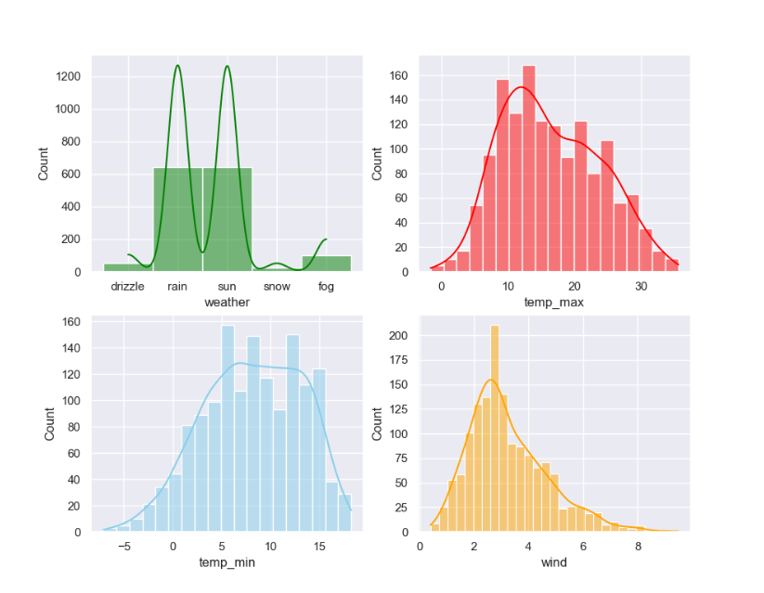
Let’s explore data

Slide 3
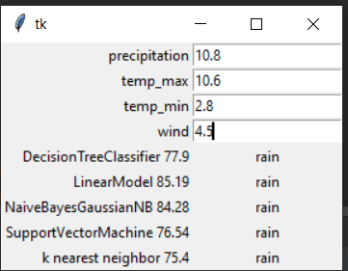
Tkinter GUI

Slide 4
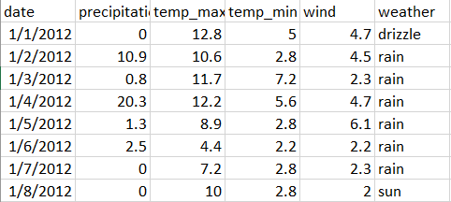
data

Slide 5
Cleaning data phase

Slide 6
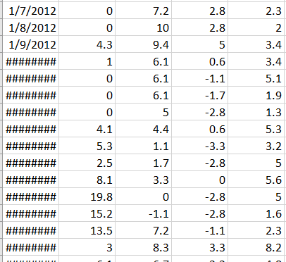

Delete column date
Why we drop column date?
Drip the date code
We need to predict the weather without using date feature

Slide 7
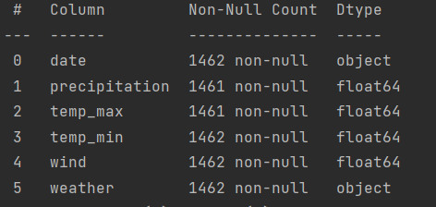

Slide 8
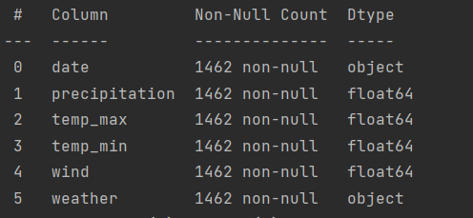

Slide 9
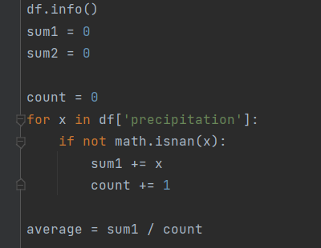
check data info and replace nan with average value

Slide 10

Split data test size is .3

Slide 11
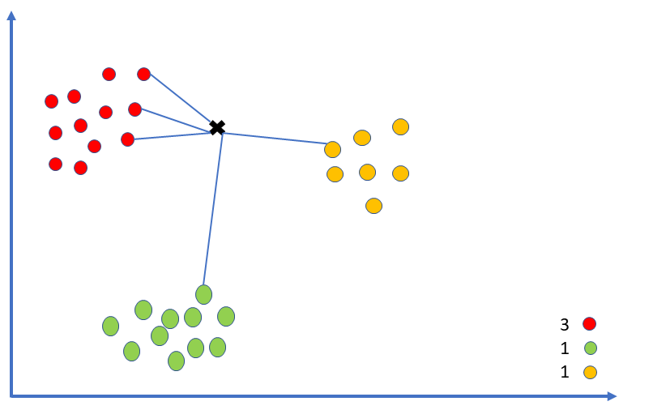
KNN

Slide 12
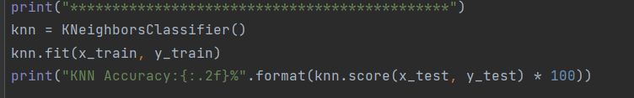
Train the model with KNN and check score

Slide 13
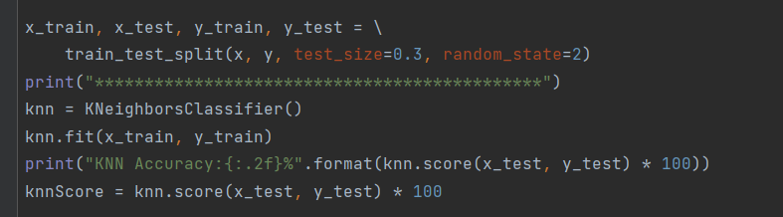
KNN trainning code

Slide 14

KNN Accuracy

Slide 15
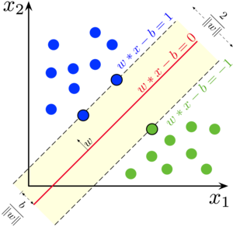
SVM

Slide 16
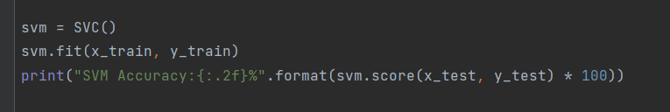
Train model with SVM and check score

Slide 17

SVM Accuracy

Slide 18
K-Means
We are given a data set of items, with certain features, and values for these features (like a vector). The task is to categorize those items into groups. To achieve this, we will use the kMeans algorithm; an unsupervised learning algorithm. ‘K’ in the name of the algorithm represents the number of groups/clusters we want to classify our items into.

Slide 19
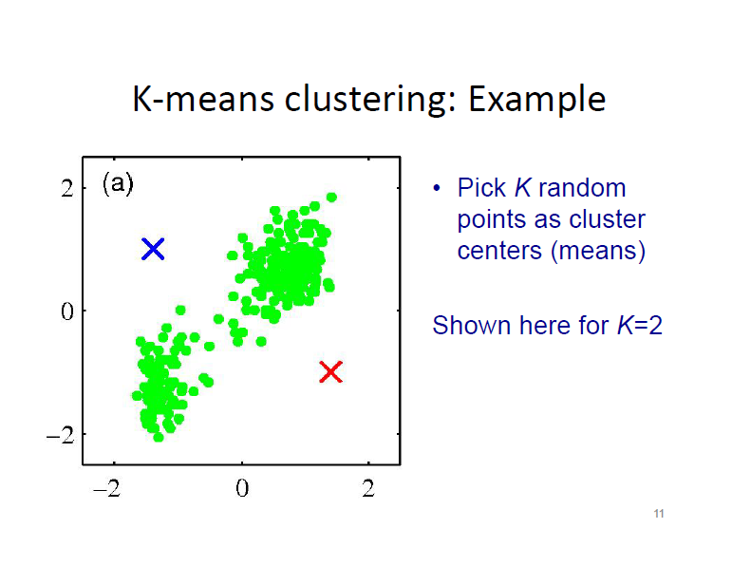

Slide 20
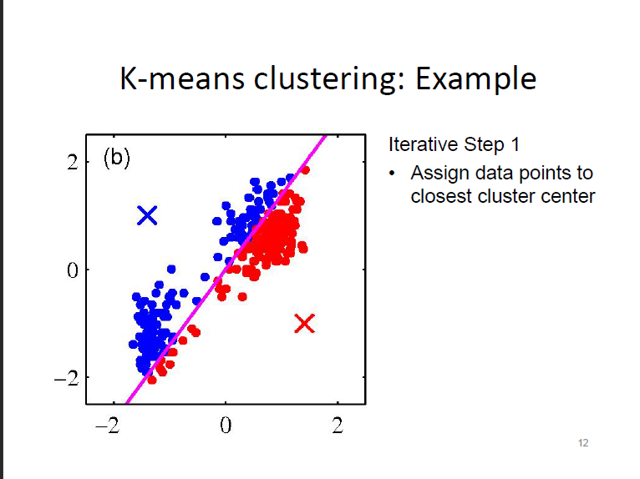

Slide 21
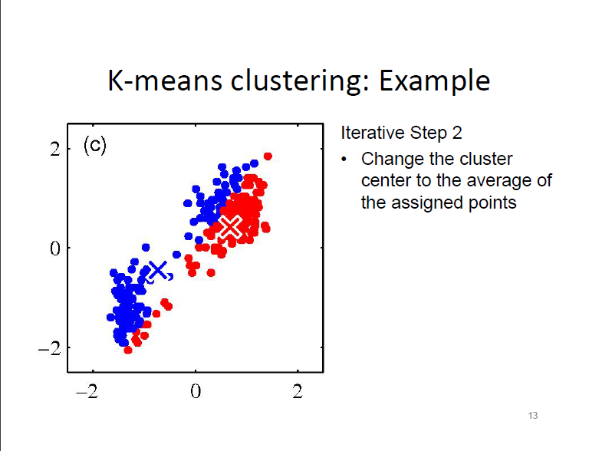

Slide 22
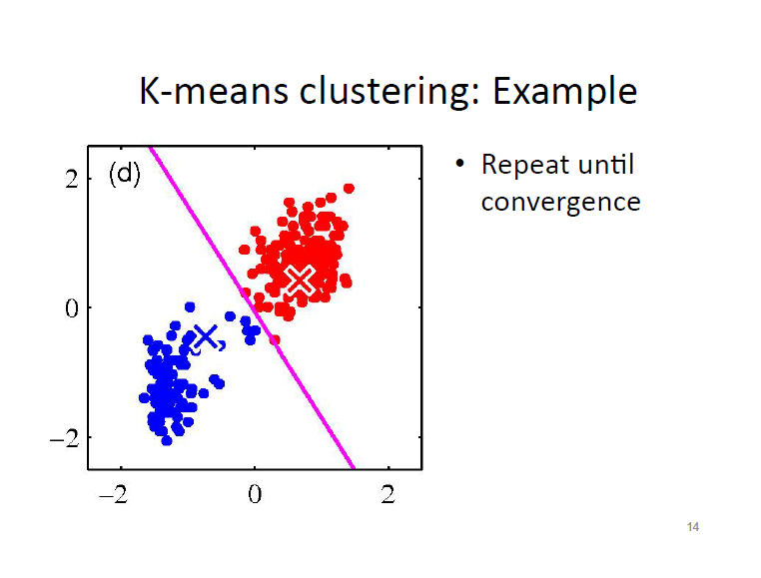

Slide 23
Association Rules
is a Data Mining technique that finds patterns in data.
we can find rules that will predict the occurrence of an item based on the occurrences of other items in the transaction.

Slide 24
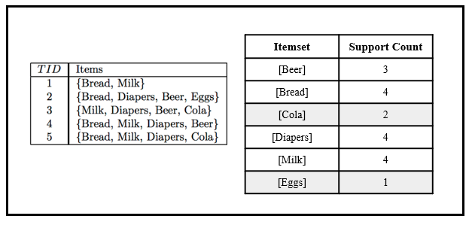

Slide 25

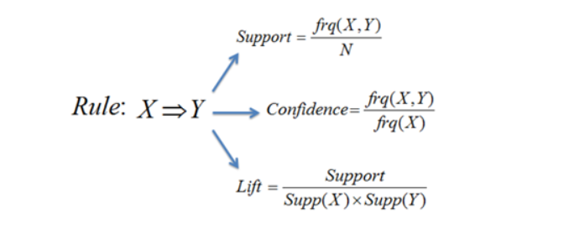
Support : It is the probability of an event to occur. Confidence : It is a measure of conditional probability Lift : It is the probability of all items occurring together divided by the product of antecedent and consequent occurring as if they are independent of each other.

Slide 26
Naïve Bayes Classifiers
Naive Bayes classifiers are a collection of classification algorithms based on Bayes’ Theorem not a single algorithm but a family of algorithms where all of them share a common principle, i.e. every pair of features being classified is independent of each other.

Slide 27
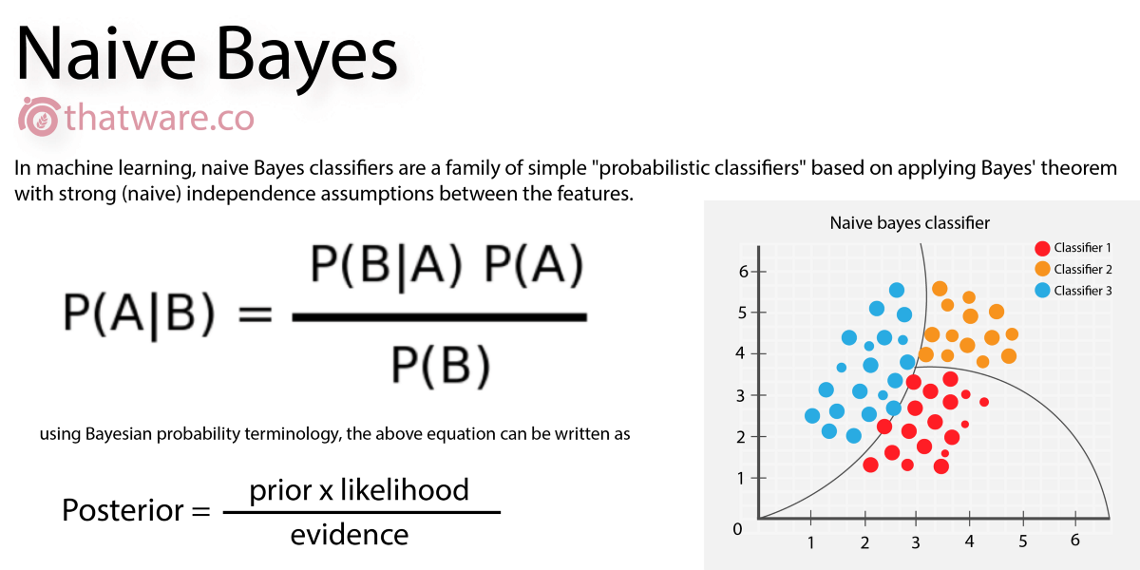

Slide 28

Accuracy for Naive

Slide 29
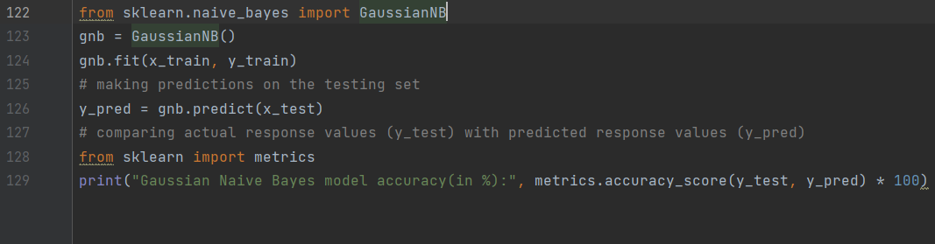

Slide 30
Logistic Regression
The logistic regression statistic modeling technique is used when we have a binary outcome variable. For example: given the parameters, will the student pass or fail? Will it rain or not? etc.

Slide 31
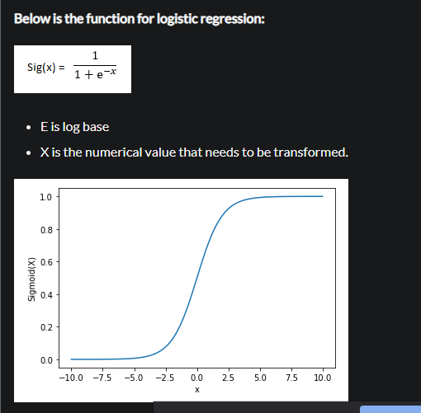

Slide 32


Slide 33
Decision Tree
Decision tree algorithm falls under the category of supervised learning. They can be used to solve both regression and classification problems. Decision tree uses the tree representation to solve the problem in which each leaf node corresponds to a class label and attributes are represented on the internal node of the tree. We can represent any boolean function on discrete attributes using the decision tree.

Slide 34
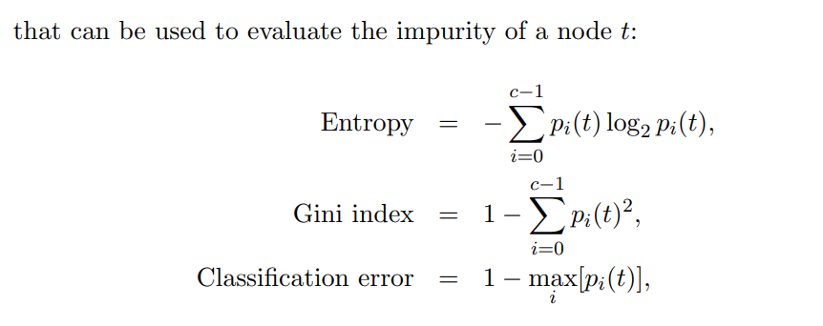
Which attribute to start from splitting

Slide 35
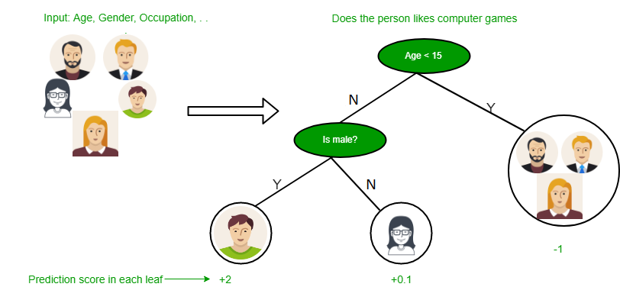

Slide 36


